Slide 1

Smart Specialisation for Kiev city
Kiev, 29 November, 2019
Lina Stanionyte

Slide 2






    Concept of Smart Specialisation
Setting transformative agendas relying on four main features
Localisation: focused on territorial specificities
Prioritisation: targeting most promising potential for development/transformation
Customisation: no "one size fits all" – adapted to local context and institutions
Mobilisation: involving public and private stakeholders
Combining evidence-based and community-based knowledge
Sources: all pictures, European Commission; bottom right picture, osame, © Adobe Stock, 2018

Slide 3
Why smart specialisation for cities
To benefit from rich ecosystems to boost urban agendas
Entrepreneurial discovery process helps to activate business
To have transitions towards knowledge based economy
S3 works as a driver to promote economic development with better focus
Prioritisation helps to rethink and to refine policy mix
Helps to refine and better focus: cluster policies, entrepreneurship, spatial planning, attraction of investment and talent

Slide 4

Concept of smart specialisation
Economic potential
Innovative potential
Societal challenges
Scientific potential
Opportunities to move up the value chains
Niches to compete on international markets
Adding value to existing activities
Create new solutions

Slide 5


    Smart Specialisation, What's special in the S3 approach?
Not a "Neutral" Policy
supports selective intervention, not only horizontal measures that cut across the whole economy
requires identifying a limited number of priorities and concentrating investment on them
Choices Based on "Entrepreneurial" Knowledge
No central and omniscient planner
Use the (tacit) knowledge of the actors
Interactive process of knowledge exchange and creation
Hausmann and Rodrik 2003; Foray and Goenaga 2013; Foray 2015

Slide 6
Smart Specialisation in Eastern Partnership
Advanced:
Ukraine
Moldova
Starting:
Georgia
Belarus
First interest:
Armenia

Slide 7
S3 Framework for Enlargement and Neighbourhood Countries
INSTITUTIONAL CAPACITY BUILDING
MAPPING EXERCISE
ENTREPRENEURIAL DISCOVERY PROCESS
INSTITUTIONAL CAPACITY FOR IMPLEMENTATION
FINAL S3 STRATEGY
Moldova
Ukraine
Moldova
Ukraine
Georgia
Belarus
Moldova
Ukraine

Slide 8
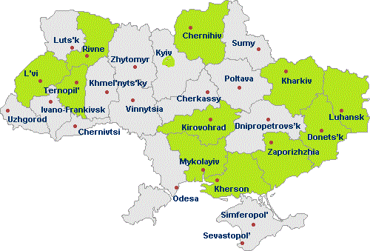
Recent developments - Ukraine
Capacity building expert support in the regions for developing smart specialisation frameworks, September – November, 2019
8 EU experts + National S3 team
12 Expert missions
12 administrations - 11 Regions and Kiev city -received support
approx 250 stakeholders reached

Slide 9

Vision post 2020
Improved research and innovation networks in Eastern Partnership Countries and their links with the EU

