Slide 1

Smart specialisation – do it yourself!
Katarzyna Kaczkowska, poland
kyiv, november 2019

Slide 2
definition
Public investment
Place-based
Smart Specialization
Priorities
Research, development and innovation
Bottom-up

Slide 3
Framework – road to smart specialization
Institutional capacity building
Diagnosis / mapping
Stakeholder dialogue
Institutional capacity for implementation
Final strategy

Slide 4
Framework
Institutional capacity building
Diagnosis / mapping
Stakeholder dialogue
Institutional capacity for implementation
Final strategy

Slide 5
Institutional capacity building
Decision to start smart specialization process
  Discussion within public administration
  Awareness event
  Appointment of regional/national S2 team
Analysis of strategic mandates
  Overview of existing documents on suport for research, development and innovation (RDI)
  Decision on placement of RIS3 in strategy architecture the region/country

Slide 6
Institutional capacity building – hints & tips
Stable institution with leadership focused on smart specialization
People make the difference (strategic and operational level)
Do not discard existing documents – use them wisely
Smart specialization in strategic documents
Awareness event – PR is important

Slide 7
Framework
Institutional capacity building
Diagnosis / mapping
Stakeholder dialogue
Institutional capacity for implementation
Final strategy

Slide 8
Diagnosis / mapping
Analysis of existing economic, scientific and innovative potential (quantitative)
  Statistical data (numer of patents, amount of exports, numer of companies, number of innovations commercialized, expenditure on R&D etc.)
  Mapping of existing potentials – expert knowledge on context
  Additional analyses
  Consultation with stakeholders

Slide 9
Diagnosis / mapping
In-depth qualitative analysis
  Expert assessment of quantitative analysis
  Decision on domains for entrepreneurial discovery

Slide 10
Diagnosis / mapping – hints & tips
Reliable sources of data – key
Work closely with statistical office
Present your data / analyses

Slide 11
Framework
Institutional capacity building
Diagnosis / mapping
Stakeholder dialogue
Institutional capacity for implementation
Final strategy

Slide 12

Stakeholder dialogue
Enterpreneurial discovery process
  Identification of stakeholders for each domain
  EDP plan and working rules
  Definition of EDP working groups
  Workshops
  EDP input to S3
Source: Smartdublin.ie

Slide 13
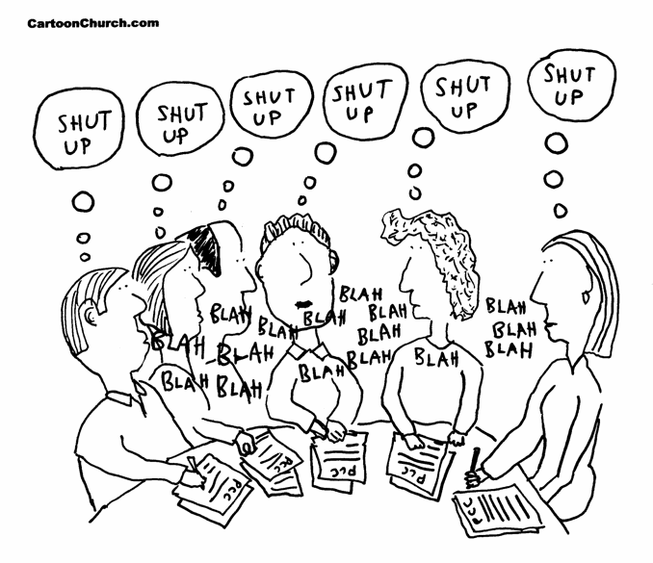
Stakeholder dialogue – hints & tips
The essence of smart specialization
Trust – a must
Existing + new networks
How to attract participants to long meetings with unknown people?
Vested interests
Moderating meetings is not a simple task

Slide 14
FrameworK
Institutional capacity building
Diagnosis / mapping
Stakeholder dialogue
Institutional capacity for implementation
Final strategy

Slide 15


Institutional capacity for implementation
Design the monitoring, implementation and financing
  Monitoring system – output and result indicators
  Implementation system – support instruments
  Budget

Slide 16
Institutional capacity for implementation – hints & tips
Estimation of indicator values
Map existing instruments & streamline them into S3
Financing – possible sources:
  Own sources of the region
  National
  EU or other international partners
  Private

Slide 17
Framework
Institutional capacity building
Diagnosis / mapping
Stakeholder dialogue
Institutional capacity for implementation
Final strategy

Slide 18
Final strategy
Preparation & publication of the document
  Document draft
  Consultation with European Commission
  Adoption by relevant authorities
  Publication

Slide 19
Final strategy – hints & tips
Nothing is final in smart specialization ☺
Make it known
A website won’t hurt

Slide 20


Thank you
The S3 framework was drafted by The S3 Platform in Joint Research Institute of the European Commission
Kasia.kaczkowska@gmail.com
+48501402132
Kasia Kaczkowska

